Slide 1
New Student Orientation: Navigating your Online School
You’ve Got This!

Slide 2
Grab your pointer tool: Would you rather live where it is always summer or winter?

Slide 3
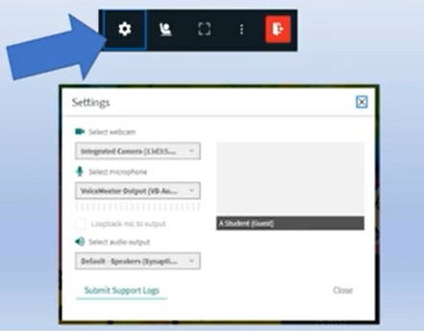
New Student Orientation
Check your audio settings—we want to make sure you can hear well!
Click on the little white gear near the top and it will navigate you through the steps ☺

Slide 4
Hello! I’m...
Here is where you introduce yourself.
You can add your name, title and a little background. Right click the image and replace it with your own.

Slide 5
New Student Orientation: Navigating the Online School
Become familiar with the Online School (OLS).
Learn how to submit an assignment, , check your daily plan, contact your teachers, access your courses, and check your grades

Slide 6
Everyday at ISMN (Insight School of Minnesota) school time will require doing these two things:
Attending and Participating live Class Connect (CC) sessions.
Completing daily coursework (lessons and assignments).

Slide 7
Where do I find my daily work each day?
Click Here

Slide 8
Daily Work List

Slide 9
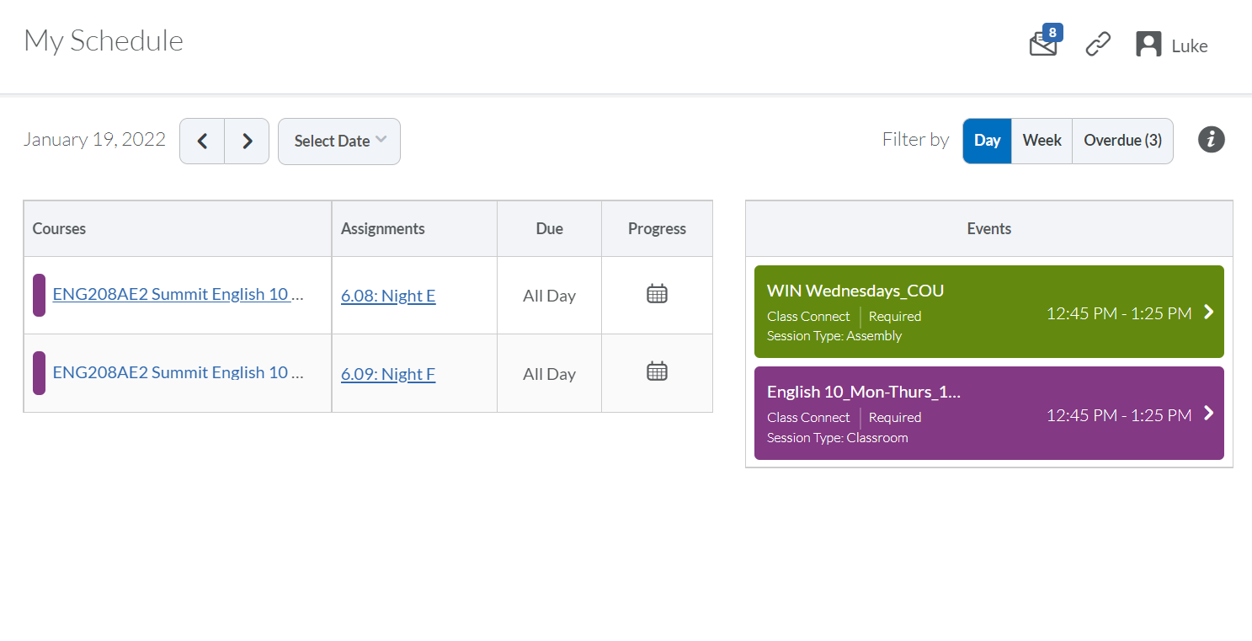
Let’s Talk Through Each Column You Will See in Daily Work
Courses

Slide 10
Where clicking on the course will take you

Slide 11
Assignments

Slide 12
Where does that take me?

Slide 13
Due Dates
“All Day” could be a link to use in a class or a reminder to a school event
“Starts”7:00 am is an assignment opening time
A red clock shows an overdue assignment
“11:30” Shows an assignment due today at that time

Slide 14
Progress
At the end of each day, you will want to check and make sure you have green checks all the way down.
Any open circles are assignments that still need to be completed.
If you see a folder, that is a module with multiple parts to the assignment.

Slide 15
Example of Module Assignment Progress

Slide 16
How to attend CC sessions!

Slide 17
Different ways to view your schedule

Slide 18
You Do!
Find your schedule in the OLS. Extra snaps if you can tell me what OLS stands for.
Locate a class from your schedule. Share it in chat!
Locate one assignment. Click on it! Share where it took you ☺

Slide 19
How to view your course content and assignments ☺
Click Here

Slide 20
Classes
Missing Work
Name of Class

Slide 21
Class Home: Announcements

Slide 22
You can toggle between your courses by choosing the home or waffle icon.
Click on the little house to take you back to the Class Home page. Choose your next core class ☺

Slide 23
How to view your course content and assignments ☺
Click Here

Slide 24
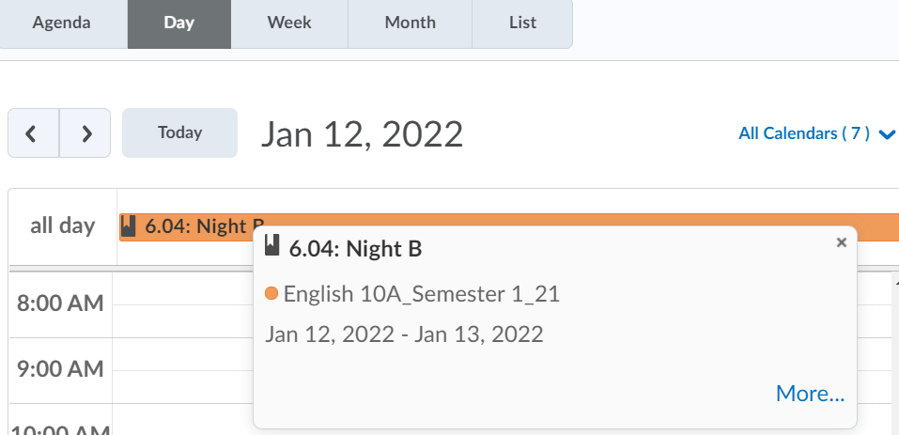
Plan
It has all assignments and lessons that are due in your course for the next few weeks.
You can click on the even for the current day and click “More” to get direct access to lesson or assignment for that day!

Slide 25
Plan: Monthly View
You can view your Plan or “Calendar” in Day, Week, or Month View
In” Month” view you can easily see a list of assignments for each day.

Slide 26
Content
This is where you will access all of your book, lessons, and assignments for the course.
Use the left navigation column to select the appropriate lesson/assignment for the day.

Slide 27
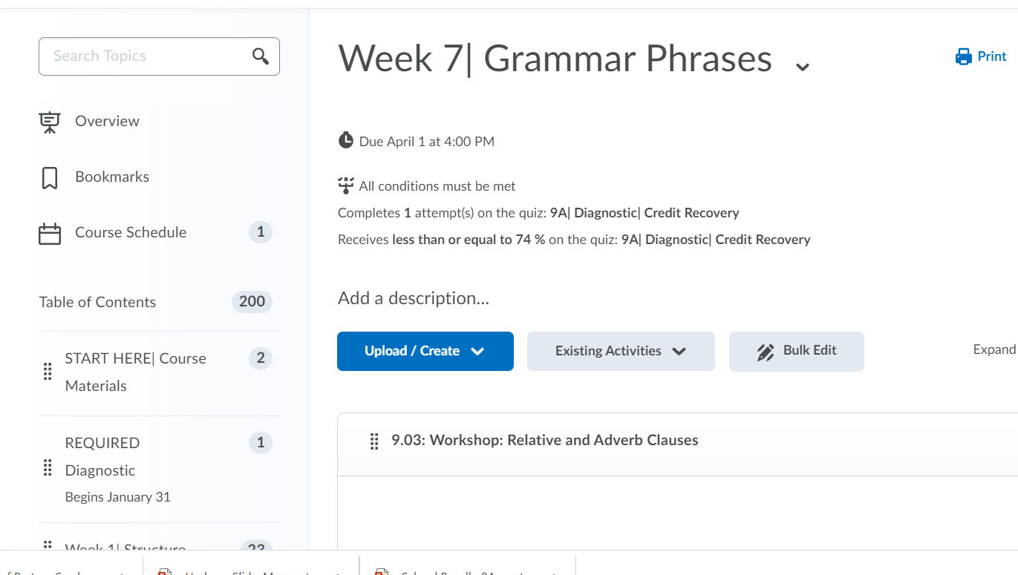

Slide 28
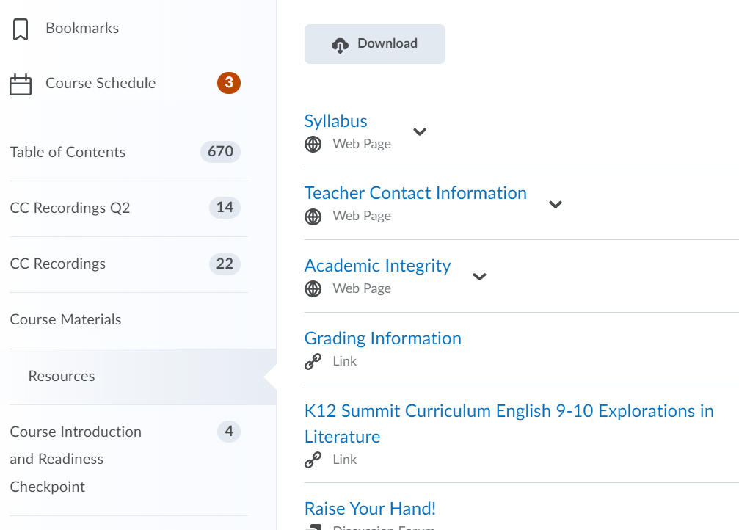
Course Materials

Slide 29
CC (In chat, who remember what that means?)Recordings

Slide 30
Select your third core class and go into that class.
Under “CONTENT” select “Start Here” and spend a few minutes looking at the available content.
Give me a ☺ when ready to move on!

Slide 31
Grades
CHECK DAILY!
ALL GRADED TESTS AND ASSIGNMENTS
ZEROS = INCOMPLETE

Slide 32
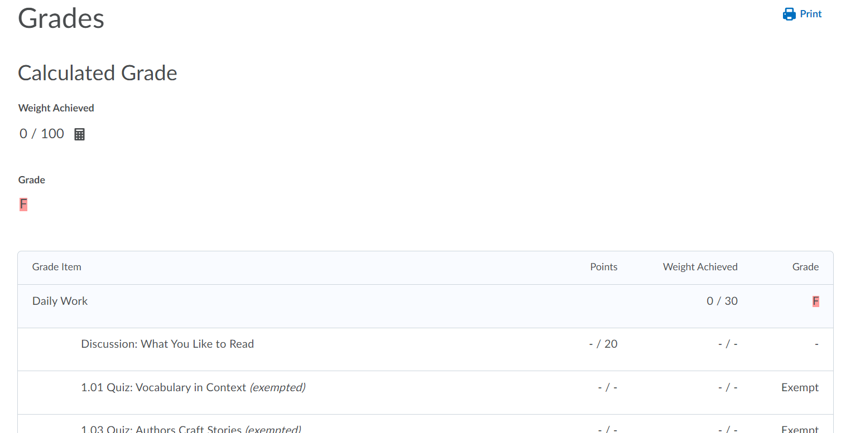
Grades

Slide 33
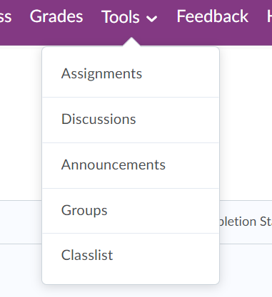
Assignments
This is a VERY important feature that you will use A LOT this semester.
Used to turn in teacher graded assignments (labs, projects, papers, etc…)
MAKE SURE YOU ARE CAREFUL TO PUT YOUR ASSIGNMENT IN THE CORRECT FOLDER.
Also note, teachers see the date and exact time an assignment is submitted.
Please check on your assignment submissions AFTER the teacher has graded it to:
Ensure the teacher has graded your assignment.
Read the important feedback a teacher has left for you.

Slide 34
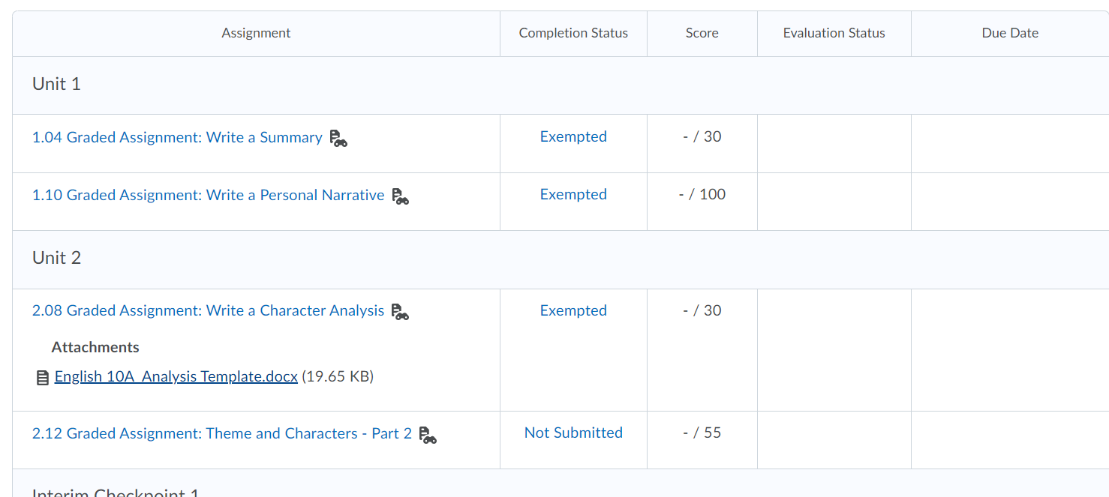
Assignments
Click on the assignment you want to submit.

Slide 35
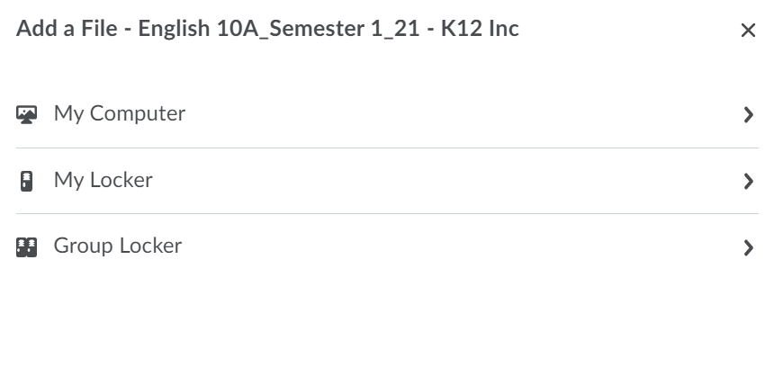
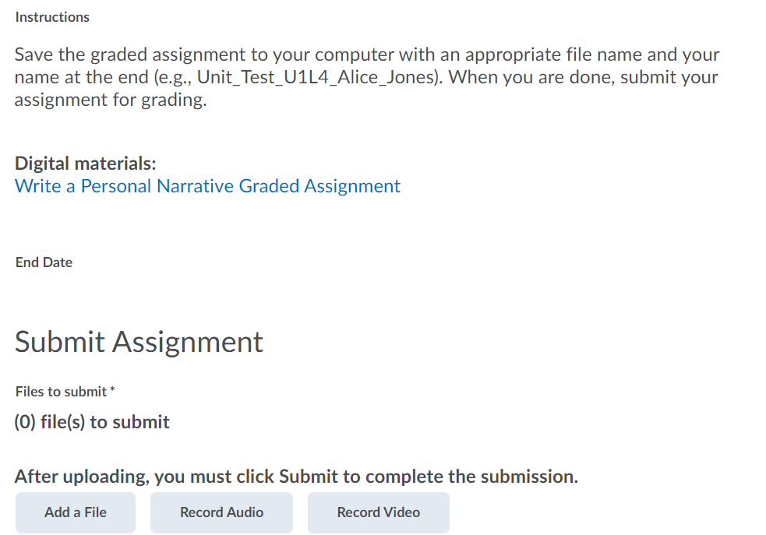
Assignments
Add the file from your computer that you wish to submit. After choosing, make sure to hit SUBMIT/UpLOAD/ADD.

Slide 36
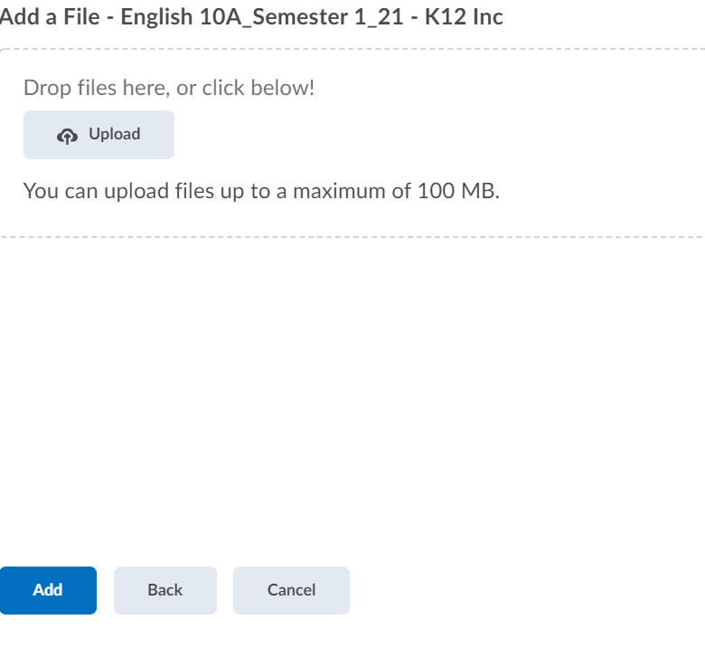
Assignments
Add the file from your computer that you wish to submit. After choosing, make sure to hit SUBMIT/UpLOAD/ADD.

Slide 37
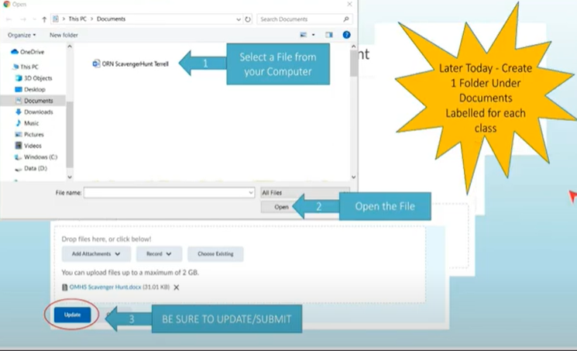
Class Folders

Slide 38
Email
Super important to CHECK your email at least once a day!

Slide 39
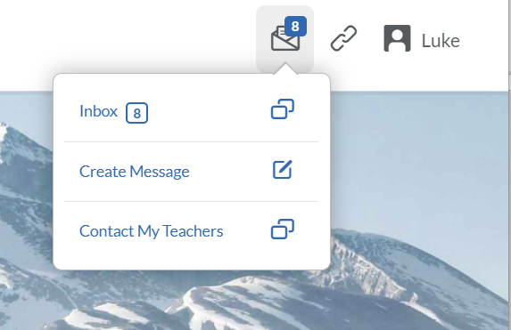
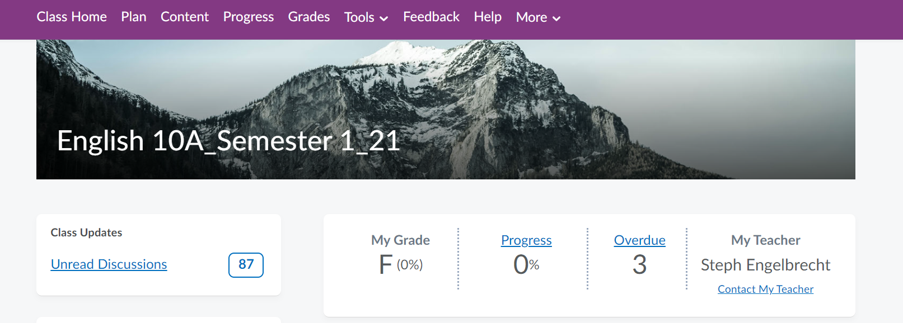
Email

Slide 40
Where do I find my daily work each day?
Click Here

Slide 41
How to view your course content and assignments ☺
Click Here

Slide 42
Classes
Missing Work
Name of Class

Slide 43
Class Home: Announcements

Slide 44
Plan
It has all assignments and lessons that are due in your course for the next few weeks.
You can click on the even for the current day and click “More” to get direct access to lesson or assignment for that day!

Slide 45
YOU HAVE GOT THIS ☺

