Slide 1
Welcome to Newrow!
Spring 2021

Slide 2
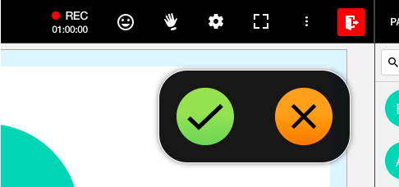
Let's Build a New Class Connect Classroom!
Give me a GREEN CHECK if you live in Northern MN
Give me an ORANGE X if you live in Southern MN

Slide 3
Newrow
Similarities to Blackboard
Changes from Blackboard
Ability to chat as a class and directly with the teacher/moderator
Writing on the whiteboard and interacting with the board
Screensharing / Appsharing
File transfer
Quick polling (green check/orange x; emoticons; ABCD; 1-5 Stars)
More webcams!
Waiting Room before session begins
Quizzes! (Multiple choice, multiple answer, open-ended questions)
Breakout rooms assigned (April – ability to move between breakout rooms will be back!)
No 1:1 or private chat between students

Slide 4
Newrow Screen
Whiteboard PowerPoint
Participants and Chat
Webcams

Slide 5
Newrow Screen

Slide 6
Newrow Screen

Slide 7
Permissions
In settings, the teacher can choose if they want their students to be able to:
Draw/annotate on the screen
Play shared files from the playlist (choose which slide everyone sees or stop/start video content)
Share their screen with everyone
Write notes in the "notes" section
View other participants in the participants menu
Participate in chat (Room and Q&A)

Slide 8
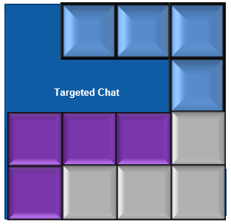
Layers of Newrow

Slide 9
Chat Options
Room (Group) Chat, Q&A (Teacher) Chat

Slide 10
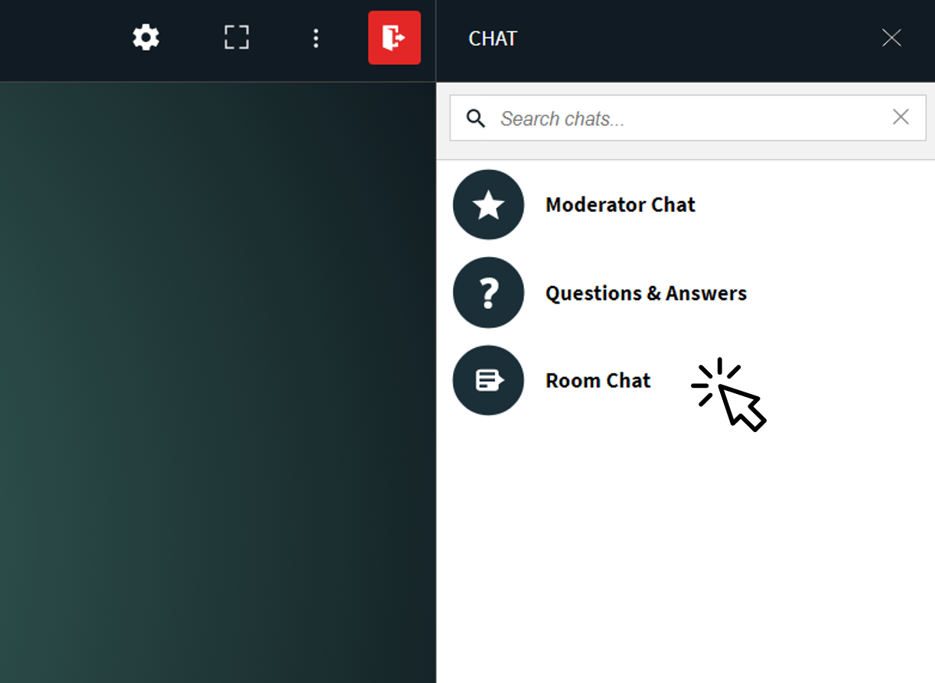
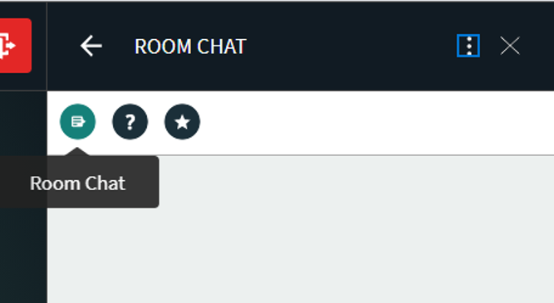
Time to Practice Using Our Tools!
1. Type in the Room (Group) Chat – Would you rather be a YouTuber or Video Game Developer?

Slide 11
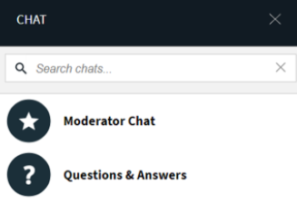
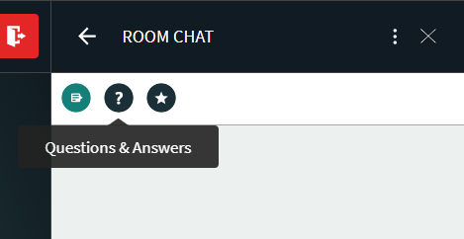
Time to Practice Using Our Tools!
2. Type in the Q&A (All Teachers) Chat – Who is your Learning Coach? (Parent, Grandparent, Sibling, etc.)
*FYI: Although only the moderators (teachers) see what anyone else types in QUESTIONS & ANSWERS, the moderator can click "Reply All" to share a question and answer with the full group.

Slide 12
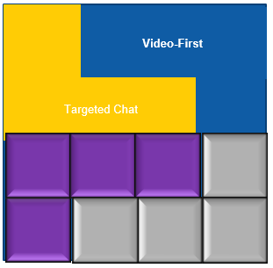
Layers of Newrow

Slide 13
Video-First....why???
Web psychologist, Liraz Margalit, notes that video is processed by our brains 60,000 times faster than text!
Viewers retain 95% of a message when watching a video compared to 10% when reading a text.
A study from 2012 (A Study of using Webcam in Computer Classroom) found that student grades improved and there was less difference between grades (meaning most students had good grades rather than some having high grades and some having low grades)!

Slide 14
Time to Practice Using Our Tools!
1. Turn on your video and share something in your room that is BLUE!

Slide 15
Time to Practice Using Our Tools!
2. Starting at the top of the participant list, we will take turns and share our name + a food we like that begins with the same first letter by turning on and off our mic!
Example: Hi, my name is Alysia and I like avocados!

Slide 16
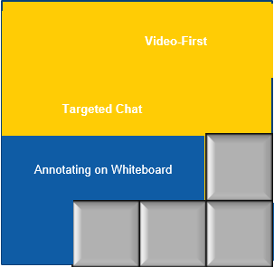
Layers of Newrow

Slide 17
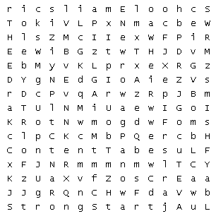
Time to Practice Using Our Tools
Use the highlighter icon to complete the wordsearch!
Word Bank:
Clubs Elks
Strong Start Newrow
Advisor Grades Tab
Mic Content Tab
School Email ReReg
Homeroom Webcam

Slide 18
Time to Practice Using Our Tools
Use the text icon to tell us what words we missed!
Word Bank:
Clubs Elks
Strong Start Newrow
Advisor Grades Tab
Mic Content Tab
School Email ReReg
Homeroom Webcam
New Words:

Slide 19
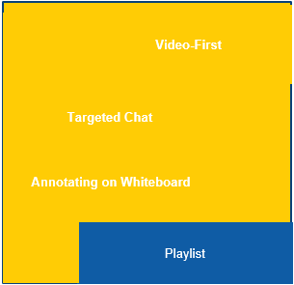
Layers of Newrow

Slide 20
YouTube
Notes:
Show participants how a video looks in the new platform - here is a video from Ms. Engelbrecht! https://youtu.be/ofbwEMc5Ixk

Slide 21
Quizzes
I will prompt a quiz now! You will be able complete quiz once I "publish" the quiz!
You will be able to see your results once I "end" the quiz :)

Slide 22
Resources
Student/Learning Coach Help Number for Newrow: 877-847-1169
Newrow tab on Weebly website (FAQ, Troubleshooting, Student/Family Guide, etc.)
Notes:
https://docs.google.com/forms/d/e/1FAIpQLSdITyNLxkn3H0NeZDjZRkoWUcLzBH_DpK3mPbYbLXFBkXNqyQ/viewform

